Slide 1

Co-Evolving Meta-Models and View Types in View-Based Development
3 October 2023
Hossain Muhammad Muctadir, Eindhoven University of Technology, Netherlands
Lars König, Karlsruhe Institute of Technology, Germany
Thomas Weber, Karlsruhe Institute of Technology, Germany
Moussa Amrani, University of Namur, Belgium
Loek Cleophas, Eindhoven University of Technology, Netherlands & Stellenbosch University, South Africa
Software Engineering and Technology cluster, Eindhoven University of Technology, Netherlands
KASTEL – Institute of Information Security and Dependability, Karlsruhe Institute of Technology, Germany
Faculty of Computer Science, Namur Digital Institute (NaDI), University of Namur, Belgium
Department of Information Science, Stellenbosch University, South Africa
Notes:
Joint work. Institution name and first name of authors

Slide 2
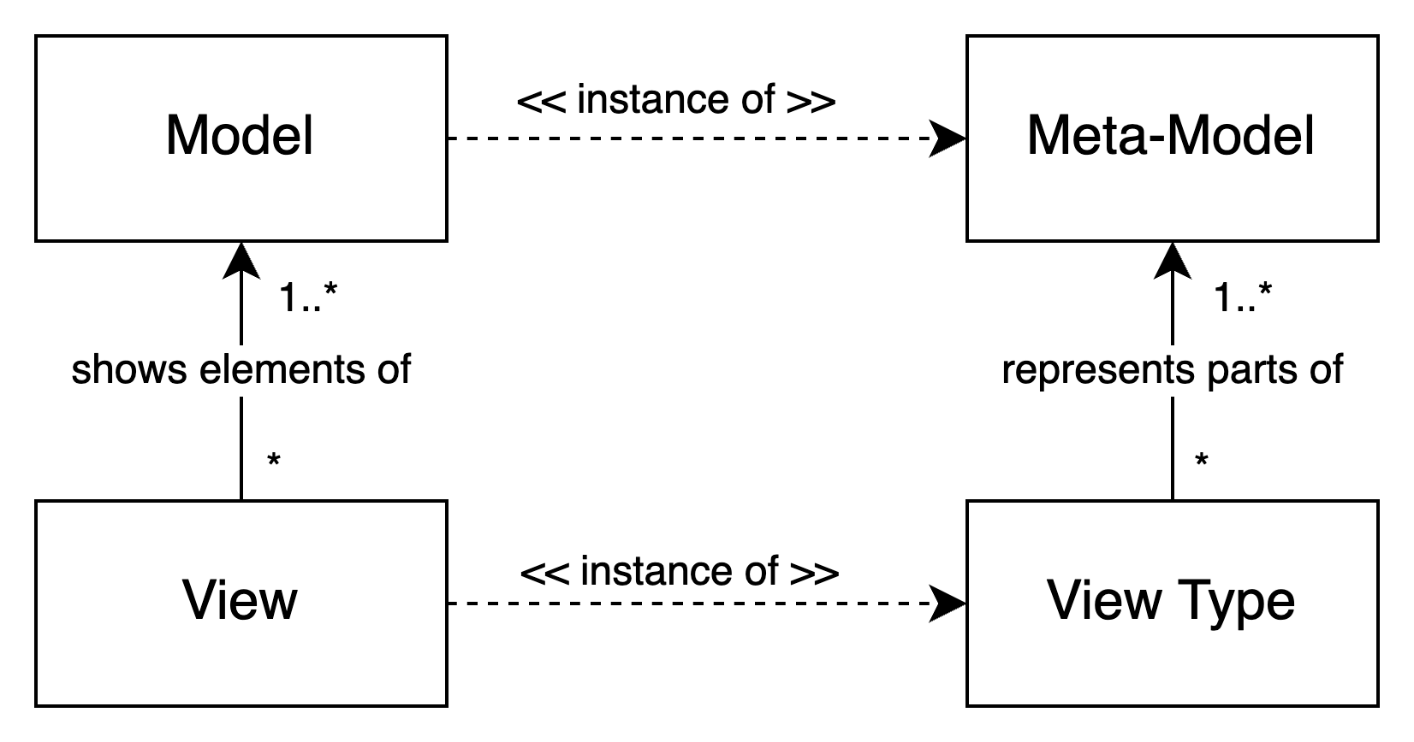
View-Based Development
Klare, H., Kramer, M. E., Langhammer, M., Werle, D., Burger, E., & Reussner, R. (2021). Enabling consistency in view-based system development — The Vitruvius approach. Journal of Systems and Software, 171, 110815. https://doi.org/10.1016/J.JSS.2020.110815

Slide 3
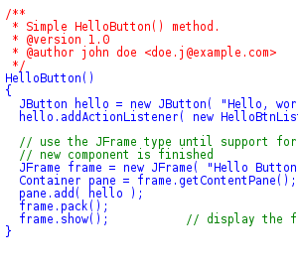
View-based development
View
instance of
View type
represents parts of
Meta-model
Klare, H., Kramer, M. E., Langhammer, M., Werle, D., Burger, E., & Reussner, R. (2021). Enabling consistency in view-based system development — The Vitruvius approach. Journal of Systems and Software, 171, 110815. https://doi.org/10.1016/J.JSS.2020.110815

Slide 4
Define view type and view based on MM
Named
name : String
<<enumeration>>
Kind
FSM
INITIAL
REGULAR
State
src
Transition
kind: Kind
1
tgt
Metamodel
fsm "Simple FSM"
number of states = 4
number of transitions = 6
state "1" initial
transition "a" to "2"
endstate
state "2"
transition "b" to "1"
transition "c" to "3"
endstate
...
endfsm
View
View Type
VT_FSM
nbStates : Int
nbTransitions: Int
name : String
State
Transition
name: String
name: String
Initial
Regular

Slide 5
How to co-evolve view types when MMs evolve?
Named
name : String
FSM
FSM
<<enumeration>>
Kind
evolution
title : String
INITIAL
REGULAR
State
src
Transition
src
kind: Kind
name: String
1
trig : String
State
1
Transition
tgt
kind: Kind
tgt
Metamodel
fsm "Simple FSM"
number of states = 4
number of transitions = 6
state "1" initial
transition "a" to "2"
endstate
state "2"
transition "b" to "1"
transition "c" to "3"
endstate
...
endfsm
View
View Type
VT_FSM
co-evolution
nbStates : Int
nbTransitions: Int
name : String
State
Transition
name: String
name: String
Initial
Regular

Slide 6

Contribution
A domain-independent approach and conceptual model for meta-model/view type co-evolution
A catalog of suggestions for the most important evolution operators
We illustrate this approach on a simple but representative example.

Slide 7
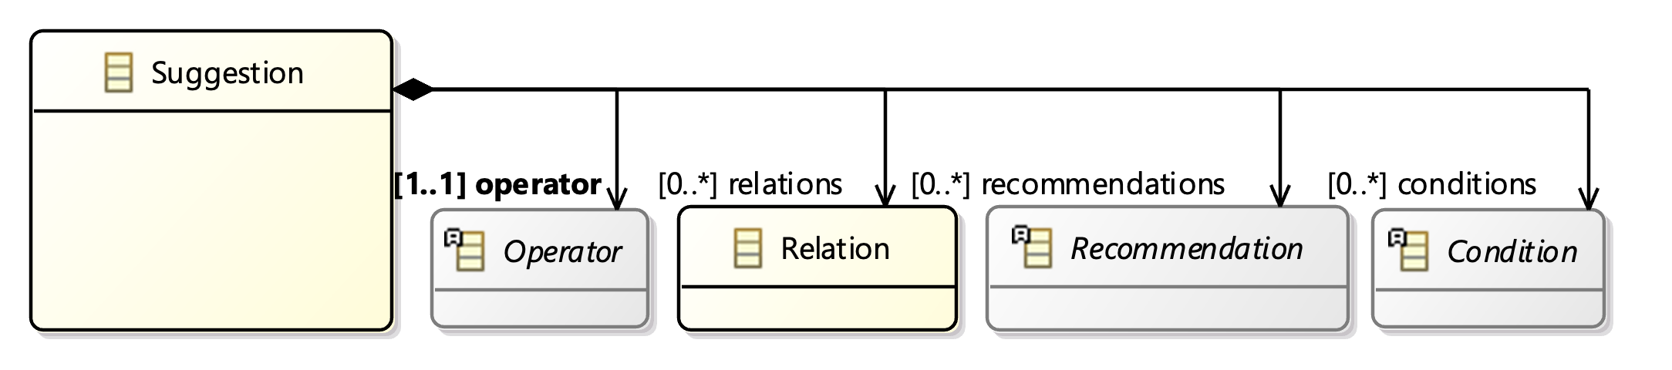
A metamodel for Suggestions

Slide 8
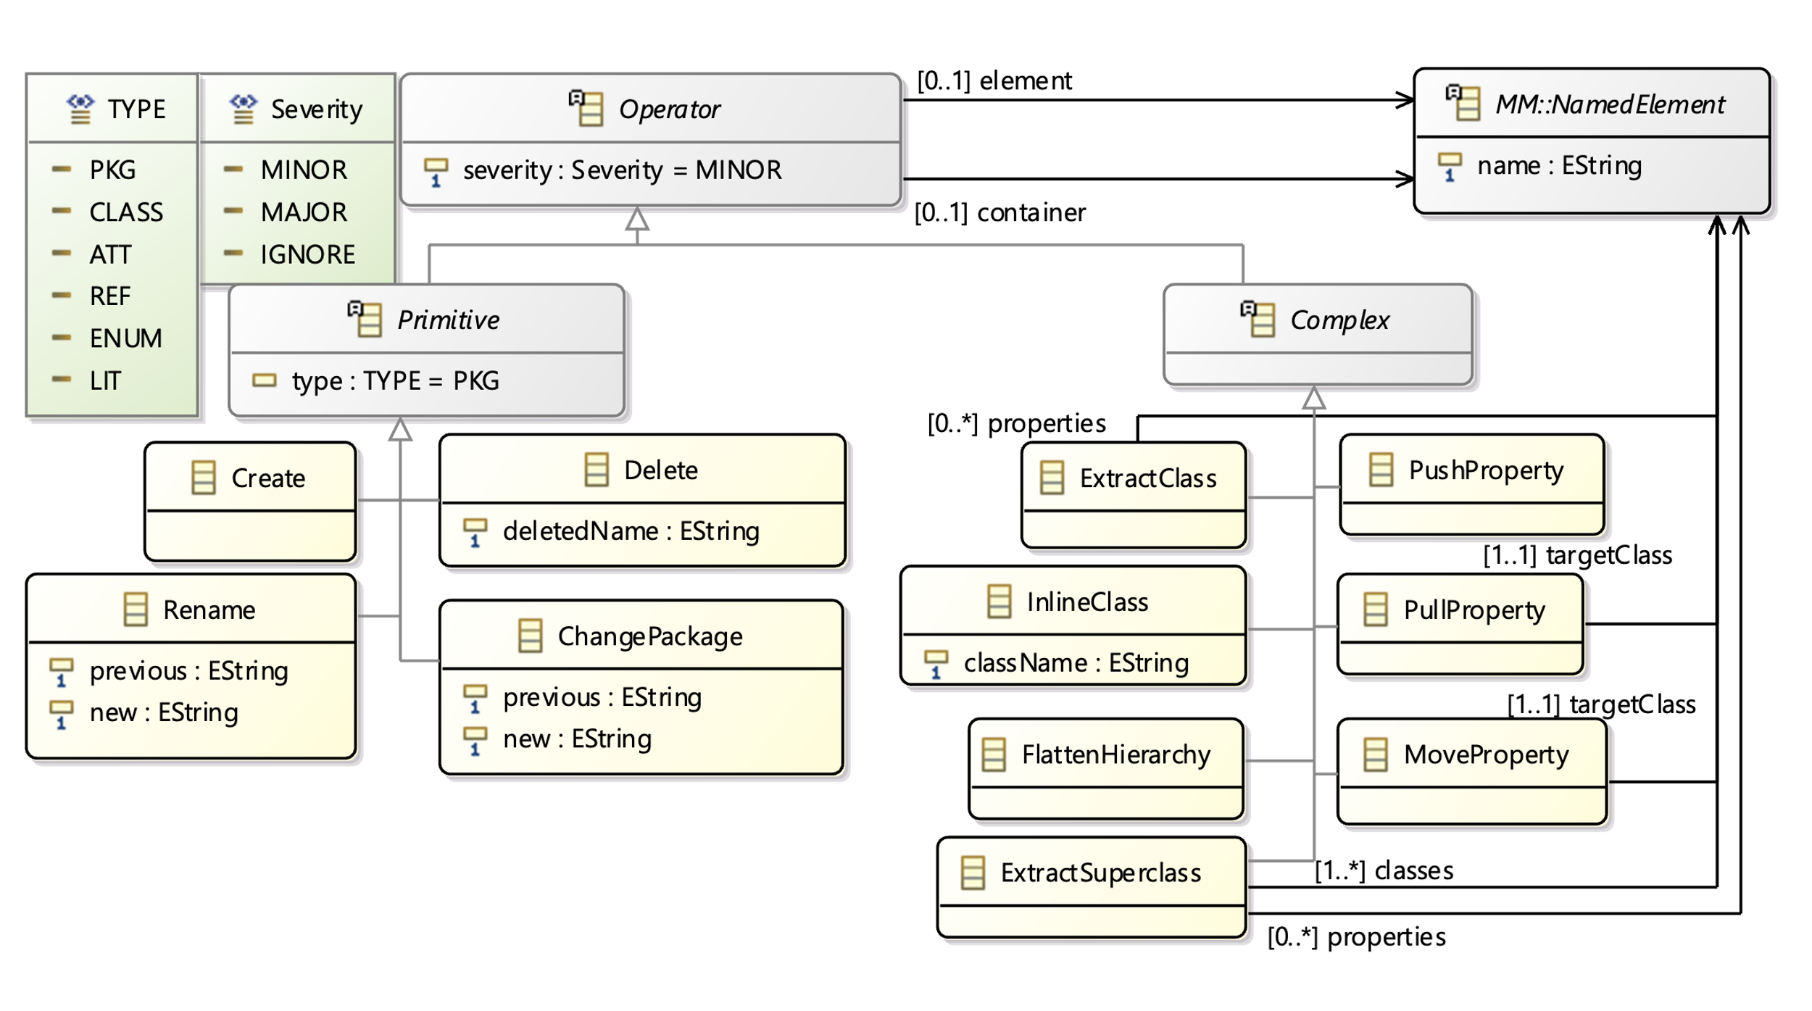
Capturing Operators for evolution
Notes:
Insert the top parts of the two papers Khelladi and Hermannsdorfer

Slide 9
Adding (rudimentary) guards/accepting State to FSMs
FSM
FSM
title : String
evolution step
title : String
State
src
Transition
State
src
Transition
<<enumeration>>
Kind
kind: Kind
name: String
1
trig : String
<<enumeration>>
Kind
kind: Kind
name: String
1
trig: String
var: String
op: String
value: String
tgt
tgt
INITIAL
REGULAR
INITIAL
REGULAR
FINAL
fsm "Simple FSM"
...
state "1" initial
transition "a" to "2" when x = 0
endstate
...
endfsm
Operator Create (Primitive) with
element as an Attribute meta-element, with name = "var"
container as Class meta-element of name "Transition"
Notes:
Insert the top parts of the two papers Khelladi and Hermannsdorfer

Slide 10
Adding (rudimentary) guards/accepting State to FSMs
Named
name : String
FSM
FSM
<<enumeration>>
Kind
evolution
title : String
INITIAL
REGULAR
State
src
Transition
src
kind: Kind
name: String
1
trig : String
State
1
Transition
tgt
kind: Kind
tgt
PushProperty (Complex) with
element = meta-element "name"
container = Class Named
targetClass = [FSM, State, Transition]
Rename (Primitive) each element

Slide 11
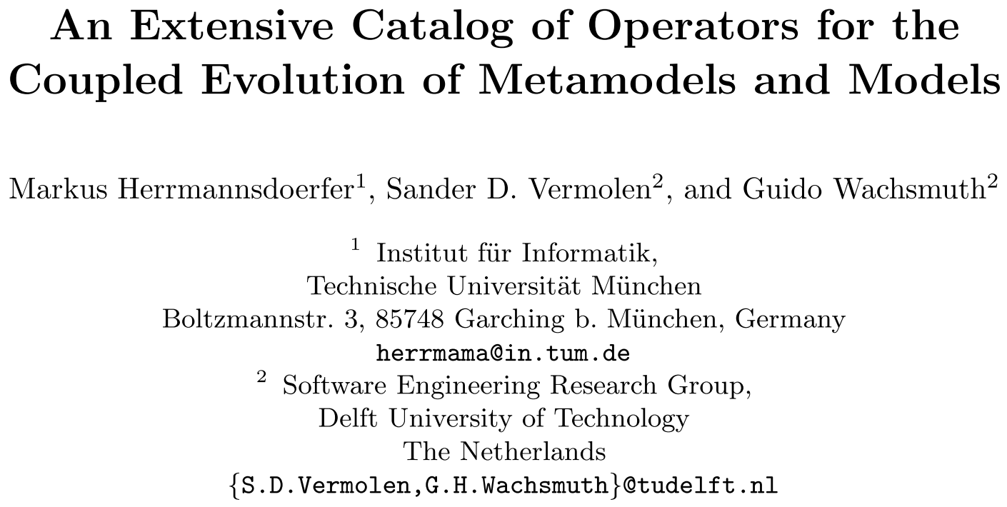
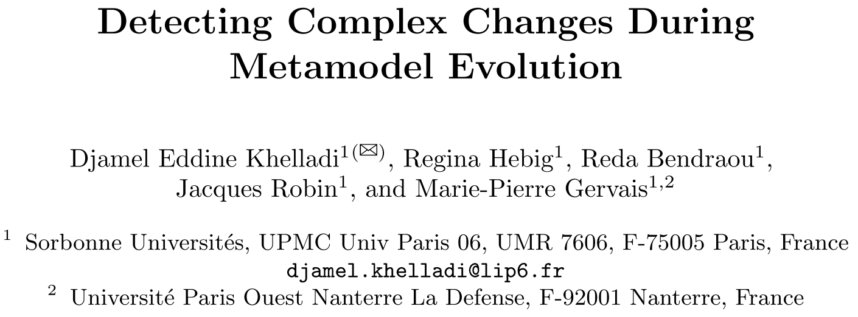
Collecting evolution operators from literature
61 evolution Operators
27 primitive
34 complex
34 evolution Operators
27 primitive
7 complex
7 Complex operators
Covering 72% of complex changes

Slide 12
A Metamodel for Suggestions

Slide 13
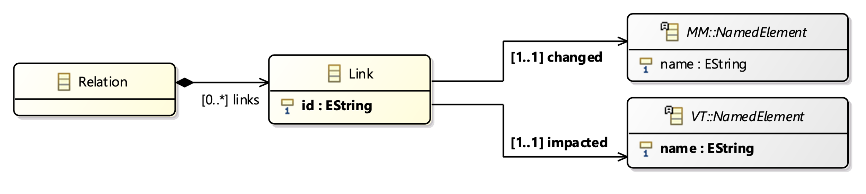
Linking MM elements with impacted VT elements

Slide 14
Finding impacted elements of Create
FSM
FSM
title : String
evolution
title : String
State
src
Transition
State
src
Transition
<<enumeration>>
Kind
1
<<enumeration>>
Kind
kind: Kind
name: String
1
trig: String
var: String
op: String
value: String
kind: Kind
name: String
tgt
trig : String
tgt
INITIAL
REGULAR
INITIAL
REGULAR
FINAL
VT_FSM
nbStates : Int
nbTransitions: Int
name : String
State
Transition
name: String
name: String
Initial
Regular

Slide 15
A Metamodel for Suggestions

Slide 16
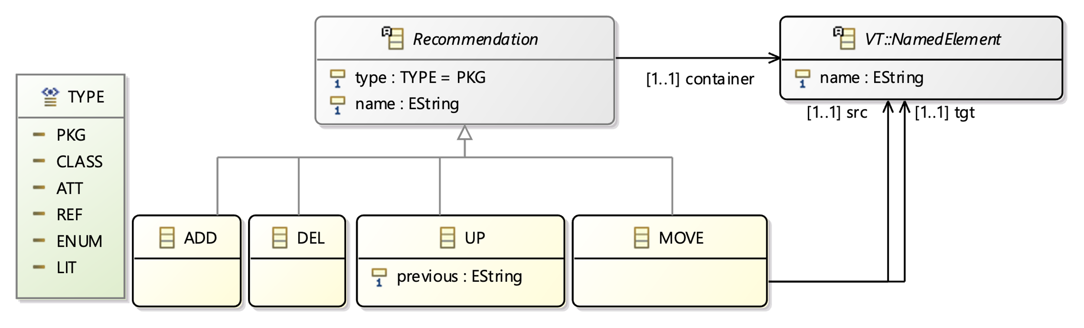
Recommending actions for VT co-evolution

Slide 17
Finding impacted elements of Create
FSM
FSM
title : String
evolution
title : String
State
src
Transition
State
src
Transition
<<enumeration>>
Kind
1
<<enumeration>>
Kind
kind: Kind
name: String
1
trig: String
var: String
op: String
value: String
kind: Kind
name: String
tgt
trig : String
tgt
INITIAL
REGULAR
INITIAL
REGULAR
FINAL
VT_FSM
nbStates : Int
nbTransitions: Int
name : String
ADD Recommendation with
type = ATT
name = var, op, value
container = Transition Class
State
Transition
name: String
name: String
Initial
Regular

Slide 18
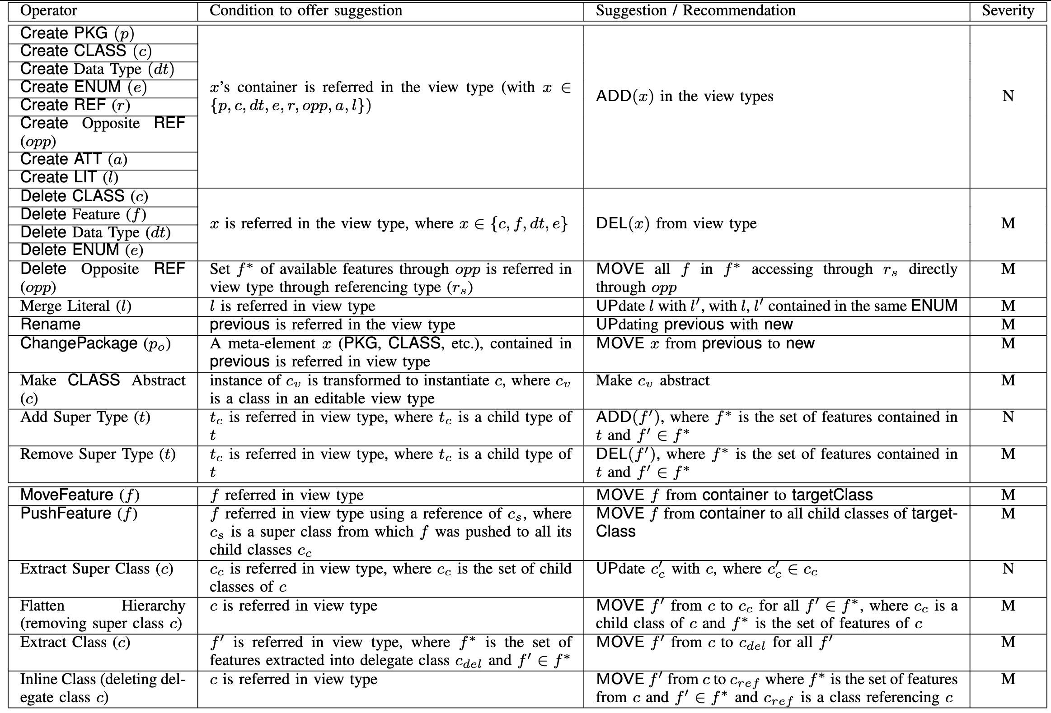
Catalog of suggestions
Primitive
Complex

Slide 19

Discussion
Suggestions closely follow the operators
Suggestions can be extended for view generation transformations
FSM example too simplistic

Slide 20


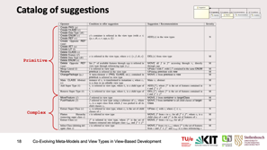
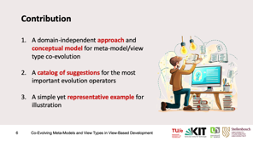
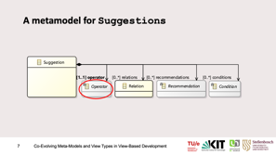
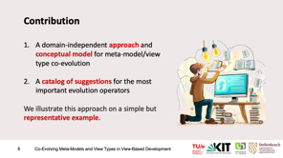
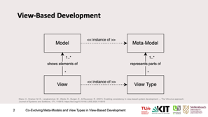


Thanks for your attention
h.m.muctadir@tue.nl
muctadir.github.io

Slide 21
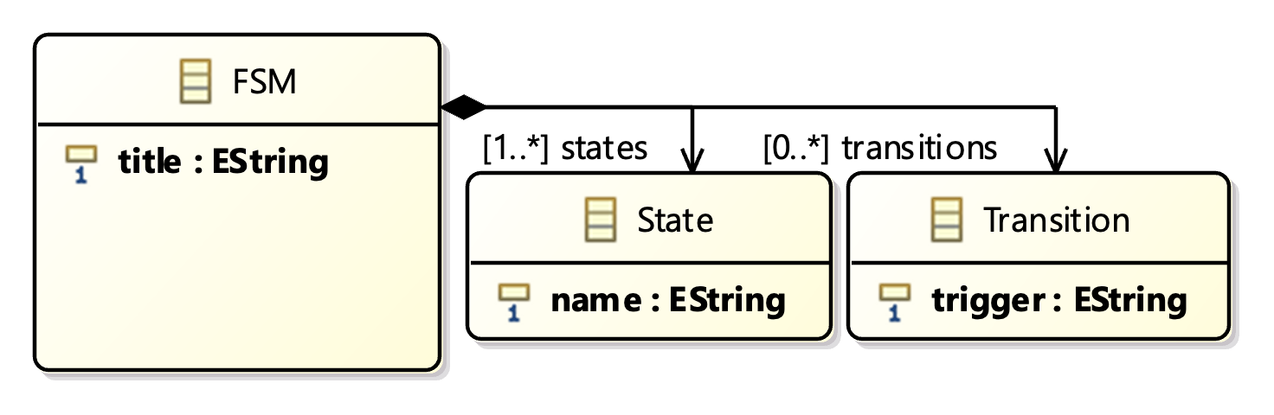
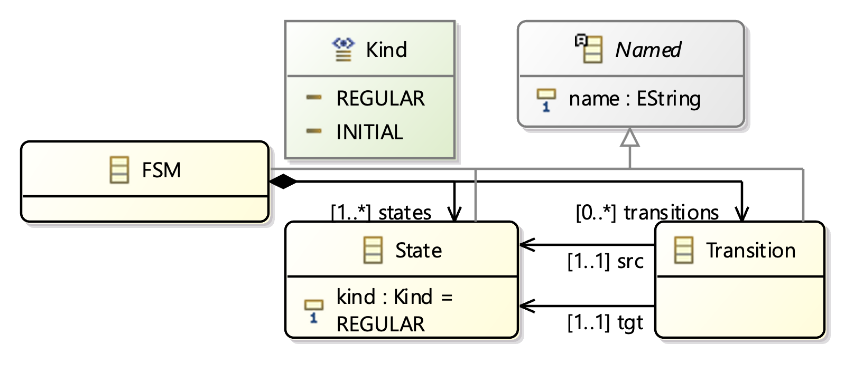
Contribution
A simple yet representative example
<<PushFeature∙Raname∙Rename>>

Slide 22
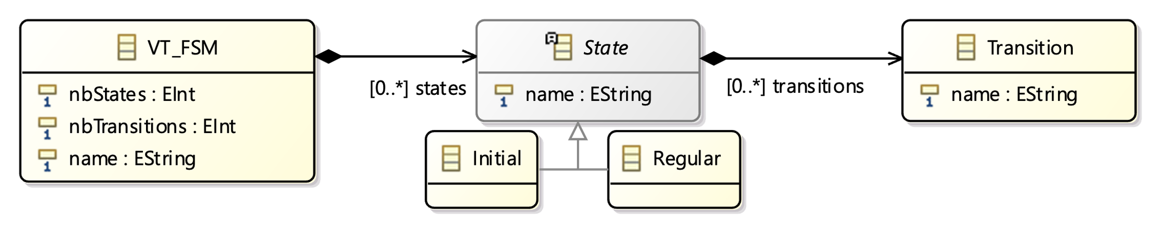
Contribution
A simple yet representative example
<<PushFeature∙Rename∙Rename>>

Slide 23
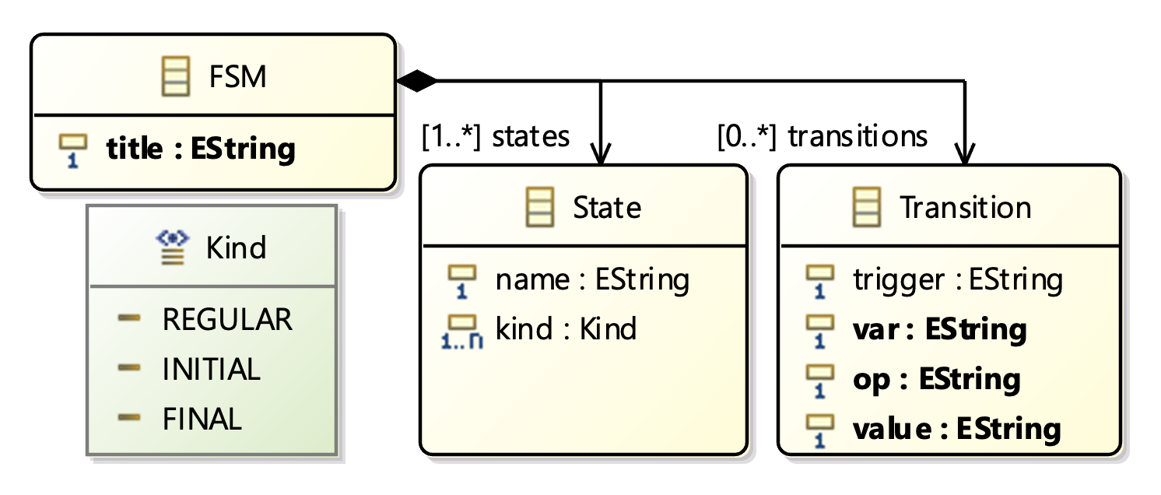
Contribution
A simple yet representative example
<<Create∙Create∙Create∙Create>>

Slide 24
Contribution
A simple yet representative example
<<Create∙Create∙Create∙Create>>

Slide 25
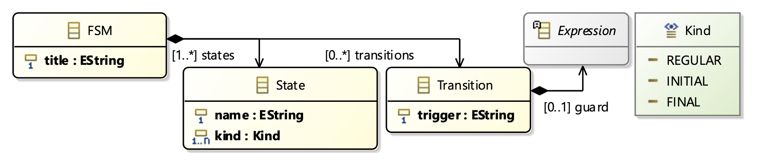

Slide 26
